Slide 1
Artificial Intelligence
Class: T.Y. B.Tech.
Course Code: DJ19CEC503
An adaptation of online resources for educational purpose

Slide 2
Database Management Systems
Pre-requisite: . Basic Mathematics, Algorithms
Course Objectives:
Provide the basic ideas and techniques underlying the design of intelligent systems.
Impart the knowledge of various search techniques for problem solving.
Learn knowledge representation and provide the knowledge to deal with uncertain and incomplete information.
Impart the knowledge of planning and forms of learning.
Learn to apply techniques of Artificial Intelligence to different applications
Outcomes: On completion of the course, the learner will be able to:
Develop a basic understanding of AI building blocks presented in intelligent agents.
Design appropriate problem solving method for an agent to find a sequence of actions to reach goal state.
Analyse various AI approaches to knowledge– intensive problem solving, reasoning and planning.
Design models for reasoning with uncertainty as well as different types of learning.
Design and develop the AI applications in real world scenario.

Slide 3
Syllabus
Database Management Systems (DJ19ADC303)
Unit | Description | Duration
1 | Introduction to Artificial Intelligence : Introduction, History of Artificial Intelligence, Intelligent Systems: Categorization of Intelligent System, Components of AI Program, Foundations of AI, Sub-areas of AI, Current trends in AI Intelligent Agents : Agents and Environments, The concept of rationality, The nature of environment, The structure of Agents, Types of Agents, Learning Agent. | 05
2 | Problem solving : Solving problem by Searching: Problem Solving Agent, Formulating Problems, Example Problems. Search Methods: Uninformed search, Breadth First Search (BFS), Depth First Search (DFS), Depth Limited Search, Depth First Iterative Deepening (DFID), Informed Search Methods: Greedy best first Search, A* Search, Memory bounded heuristic Search. Local Search Algorithms and Optimization Problems: Hill climbing search, Simulated annealing, Local beam search, Genetic algorithms, Ant Colony Optimization Adversarial Search: Games, Optimal strategies, The minimax algorithm, Alpha-Beta Pruning. | 12

Slide 4
Syllabus
Database Management Systems (DJ19ADC303)
Unit | Description | Duration
3 | Knowledge and Reasoning : Knowledge based Agents, The Wumpus World, Propositional Logic, First Order Logic, Inference in FOL, Forward chaining, Backward chaining, Knowledge Engineering in First-Order Logic, Unification, Resolution, logic programming (PROLOG), Knowledge Representation: Ontological Engineering, Semantic networks, Description logics, RDF, OWL, Semantic Web. Uncertain Knowledge and Reasoning: Uncertainty, Representing knowledge in an uncertain domain, The semantics of Bayesian belief network, Inference in belief network. Rule-based methods for uncertain reasoning, Dempster-Shafer theory, Fuzzy sets and fuzzy logic. | 10
4 | Planning : The planning problem, Planning with state space search, Planning graphs, Partial order planning, Hierarchical planning, Planning and Acting in Nondeterministic Domain: Sensorless planning, Contingent planning, Online replanning, Multiagent planning. | 05

Slide 5
Syllabus
Database Management Systems (DJ19ADC303)
Unit | Description | Duration
5 | Learning: Types of Learning, Inductive Learning Artificial Neural Networks: McCulloh Pitts Model, Perceptron, Feed Forward Network, Backpropagation Algorithm, Self Organizing Map. | 06
6 | Expert System: Introduction, Phases in building Expert Systems, ES Architecture Applications : Natural Language Processing, Robotics, Character Recognition, Genetic Algorithm in game playing, Travelling Salesman Problem, Best path finding, Recommender Systems, Prediction Systems, Atari Games, Face Recognition | 04

Slide 6
Books Recommended
Text Books
1. Stuart J. Russell and Peter Norvig, "Artificial Intelligence A Modern Approach “Second Edition" Pearson Education.
2. Saroj Kaushik “Artificial Intelligence”, Cengage Learning.
3. George F Luger “Artificial Intelligence” Low Price Edition, Pearson Education., Fourth edition.
4. Deepak Khemani.” A First Course in Artificial Intelligence”, McGraw Hill Education (India), 2013.
Reference Books
1. Ivan Bratko “PROLOG Programming for Artificial Intelligence”, Pearson Education, Third Edition.
2. Elaine Rich and Kevin Knight “Artificial Intelligence” Third Edition
3. Davis E.Goldberg , “Genetic Algorithms: Search, Optimization and Machine Learning”, Addison Wesley, N.Y., 1989.
4. Hagan, Demuth, Beale, “Neural Network Design” CENGAGE Learning, India Edition.
5. Patrick Henry Winston, “Artificial Intelligence”, Addison-Wesley, Third Edition.
6. Han Kamber, “Data Mining Concepts and Techniques”, Morgann Kaufmann Publishers.
7. N.P. Padhy , “Artificial Intelligence and Intelligent Systems”, Oxford University Press.

Slide 7
DBMS Laboratory
Database Management Systems Laboratory (DJ19ADL303)
Exp. No. | Suggested experiments
1 | Select a problem statement relevant to AI. i) Identify the problem ii) PEAS Description iii) Problem formulation
2 | Program to implement Family Tree in Prolog
3 | Identify and analyze uninformed search Algorithm to solve the problem. Implement BFS/DFS/DFID search algorithms to reach goal state.
4 | Identify and analyze informed search Algorithm to solve the problem. Implement A* search algorithm to reach goal state.
5 | Program to implement Local Search algorithm : Hill climbing search
6 | Program on Genetic Algorithm to solve a optimization problem in AI.
7 | Identify, analyze, implement a planning problem/Rule based Expert System in a real world scenario.
8 | Implementation on any AI Problem: Wumpus world, Tic-tac-toe, 8-Queens Problem.
9 | Program to implement learning : Perceptron Learning/Backpropagation Algorithm.
10 | Case study of an AI Application.

Slide 8
Unit 1: Introduction to Artificial Intelligence
An adaptation of online resources for educational purpose

Slide 9
What is artificial intelligence?
John McCarthy coined the word “Artificial Intelligence” at Dartmouth Conference in 1956
Human mental capabilities: perceive, understand, predict and manipulate
AI: It attempts not to just understand but also to build intelligent entities
“The Science and Engineering of making Intelligent Machines”
Any task:
Machine needs to take decision,
Choose next action based on current state
Act rationally
Machine shows intelligence: Intelligent systems/Expert Systems
Applications: Learning, writing stories, autonomous cars, playing games etc.

Slide 10
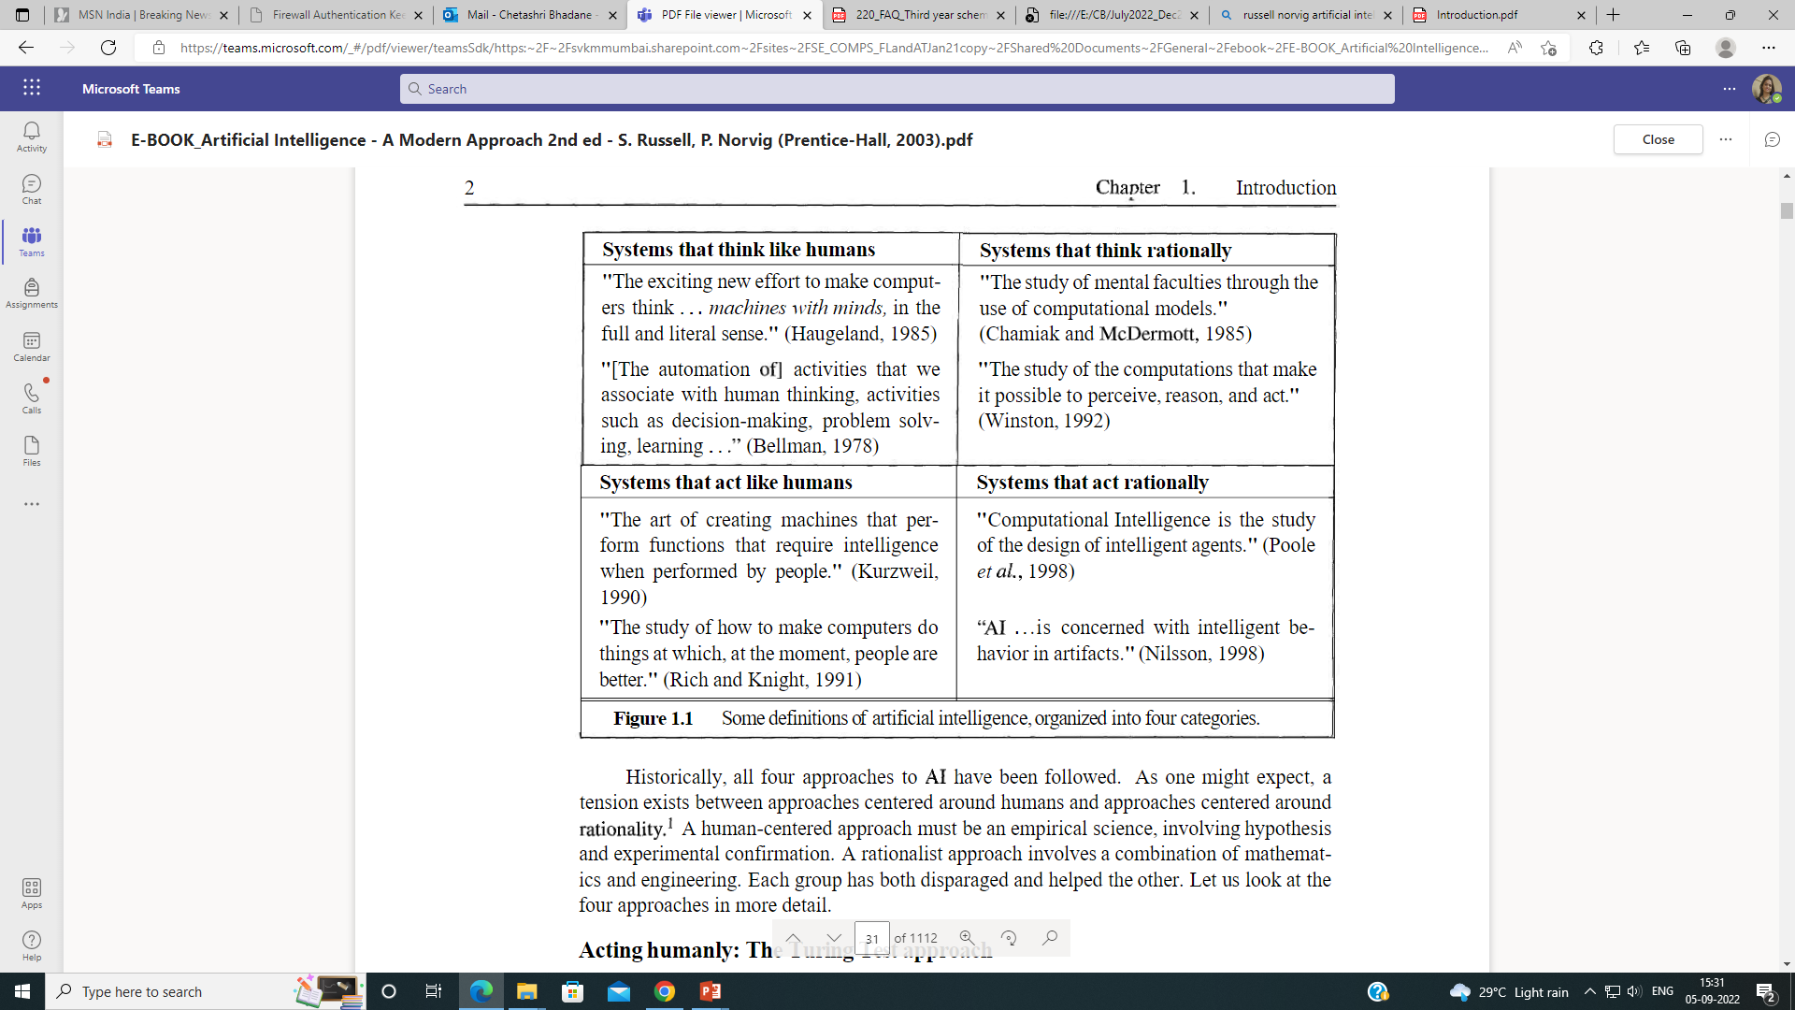
What is artificial intelligence?

Slide 11
What is artificial intelligence?
Thinking Humanly (Congnitive Model Approach) | Thinking Rationally (Law of Thought approach)
How humans think Introspection Psychological experiments Brain Imaging Cognitive science AI + experimental techniques from psychology | The Greek Philosopher Aristotle- “Right thinking” Syllogisms – patterns for argument structures Eg. Socrates is man; all men are mortal; therefore; Socrates is mortal Laws of thoughts – “Logic” Obstacles Informal to formal knowledge is difficult Solving logical problems “in principle” and “in practice” (computational constraint)
Acting Humanly (Turing Test Approach) | Acting Rationally (Rational Agent Approach)
Capabilities of computer NLP Knowledge representation Automated reasoning Machine learning Computer vision Robotics | Agent that acts to achieve best outcome when uncertainty – best expected outcome Acting rationally vs acting correct Two advantages More general than “laws of thought” approach More amenable to scientific development than human behaviour or human thought.

Slide 12
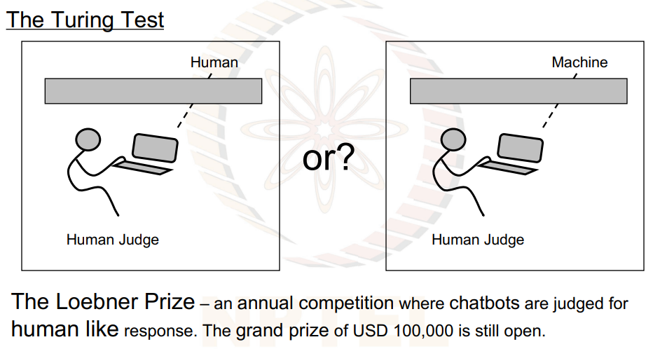
Alan’s Turing Test
(Human) judge communicates with a human and a machine over text-only channel,
Both human and machine try to act like a human,
Judge tries to tell which is which.
Numerous variants
Loebner prize
Current programs nowhere close to passing this
http://www.jabberwacky.com/
http://turingtrade.org/

Slide 13
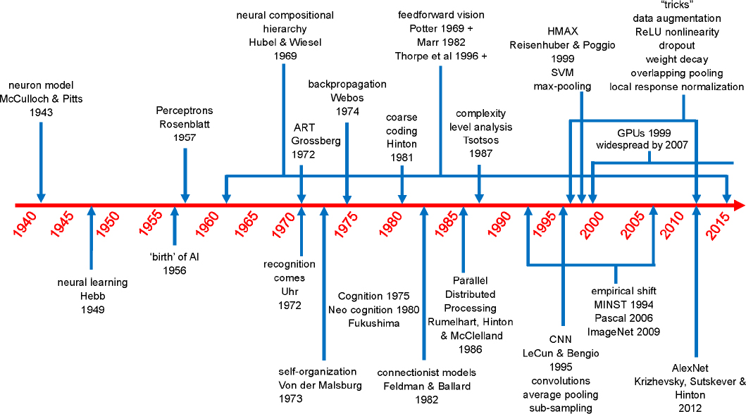
AI History

Slide 14
What can AI today?
Game playing
Autonomous control
Diagnosis
Logistics planning
Robotics
Language understanding and problem solving
Autonomous planning and scheduling

Slide 15
Some applications of AI used today!
Siri
Alexa
Tesla
Amazon.com
Netflix
Pandora
Etc etc

Slide 16
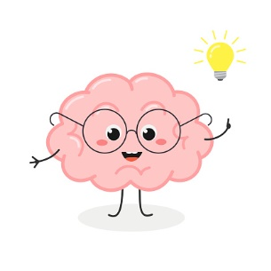
Unit 1: Intelligent Agents
An adaptation of online resources for educational purpose

Slide 17
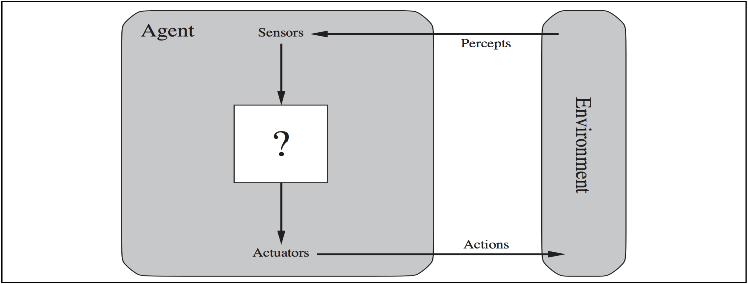
Agents
An agent is anything that can be viewed as perceiving its environment through sensors and acting upon that environment through actuators
Human agent: sensors - eyes, ears, and other sensory organs; actuators - hands, legs, mouth etc
Robotic agent: sensors - cameras and infrared range finders ; actuators - various motors for actuators
Software agent: sensors -
actuators -
Key strokes, file contents, network packets
Displaying on screen, writing files, sending network packets

